Slide 1
Apartments Prices data mining
and machine learning
Final project
Saar Salhov & Shiran Davidov

Slide 2
A little background..
Apartments Prices
Apartment prices are rising, and this has been the reality in the State of Israel for decades.
This phenomenon has worsened since the global economic crisis in 2008 and there is still no solution to this problem.
More and more young couples find themselves looking for an apartment, but over time the dream fades away.
The graphs show that all the time we are required to gain more and more salaries in order to be able to buy an apartment.
Meaning - choosing an apartment for young couples is affected by the salary they earn.
This is followed by our research question:
Is there a connection between the price of the apartment and the location of the apartment in Israel?

Slide 3
1
2
3
Crawling
Scrubbing Data
Exploring Data
Main Steps
4
5
Modeling Data
Interpreting Data
Web crawling for collecting and obtaining the data
Cleaning, formatting,
and filtering the data
Visualizing and understanding
the data
Clustering the data into groups, modeling and the algorithm
Presentation of data, understanding and delivering the results + Final predict model

Slide 4
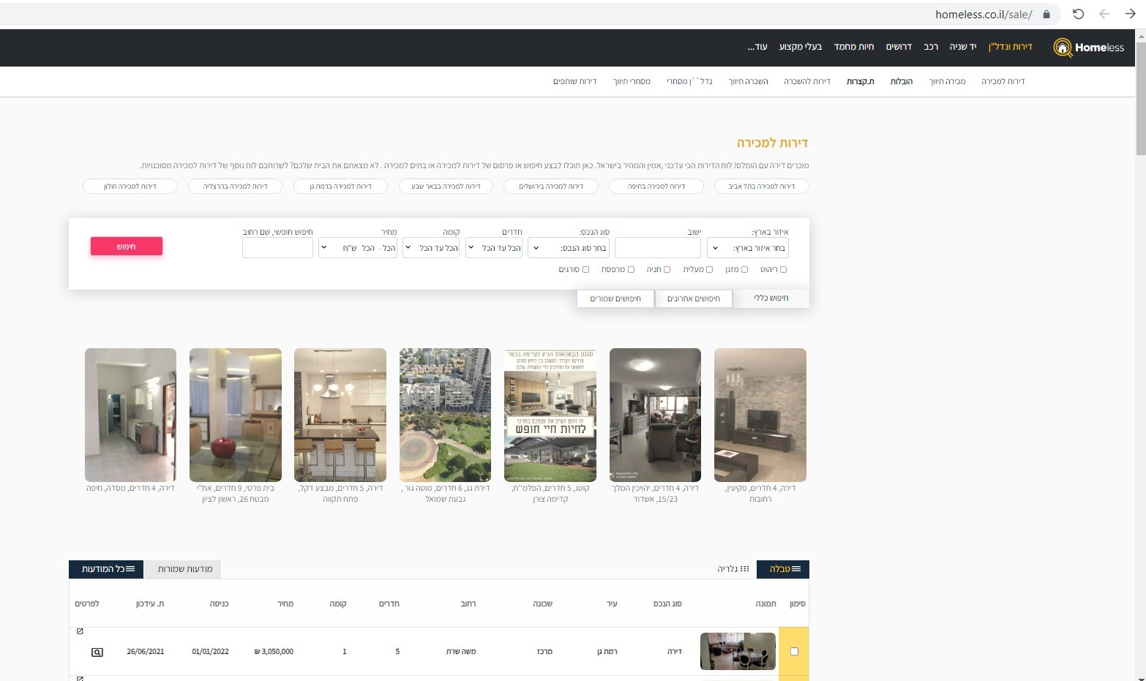
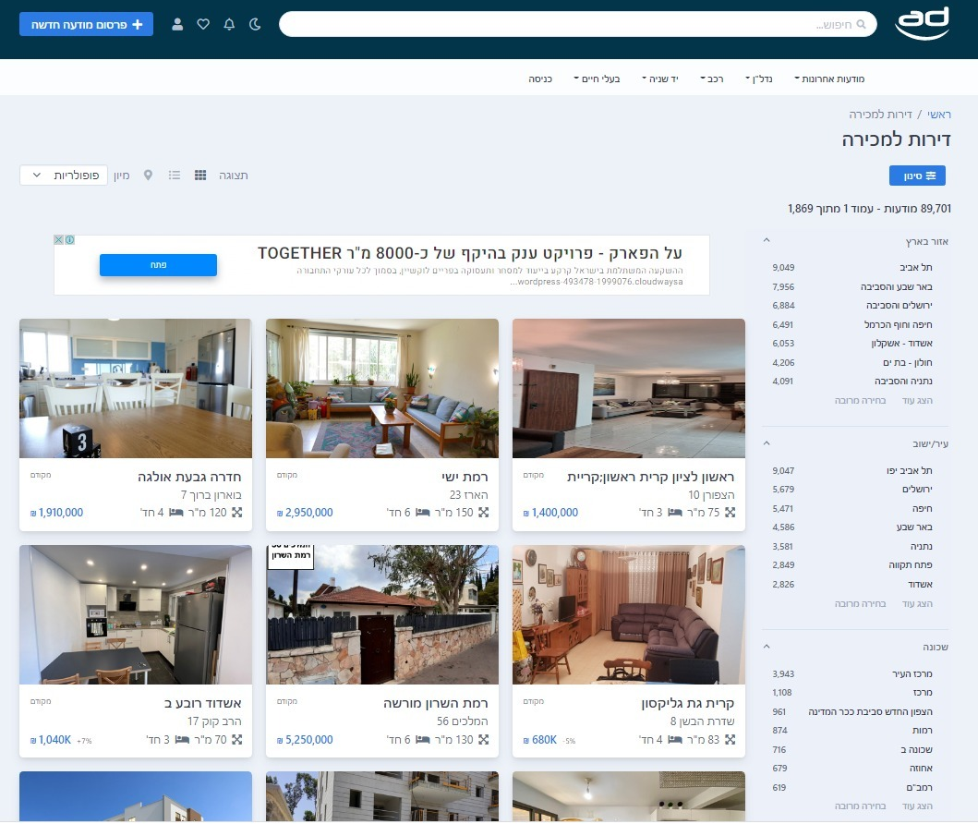
Web Crawling
Main tools: BeautifulSoup
Finding the data:
In the beginning we found a website that his name is “homeless”
We cleaned all the data and after we did machine learning it didn’t went so well So we decided to mine more data from another website
The second website called “ad”
https://www.homeless.co.il/sale/
https://www.ad.co.il/nadlansale

Slide 5
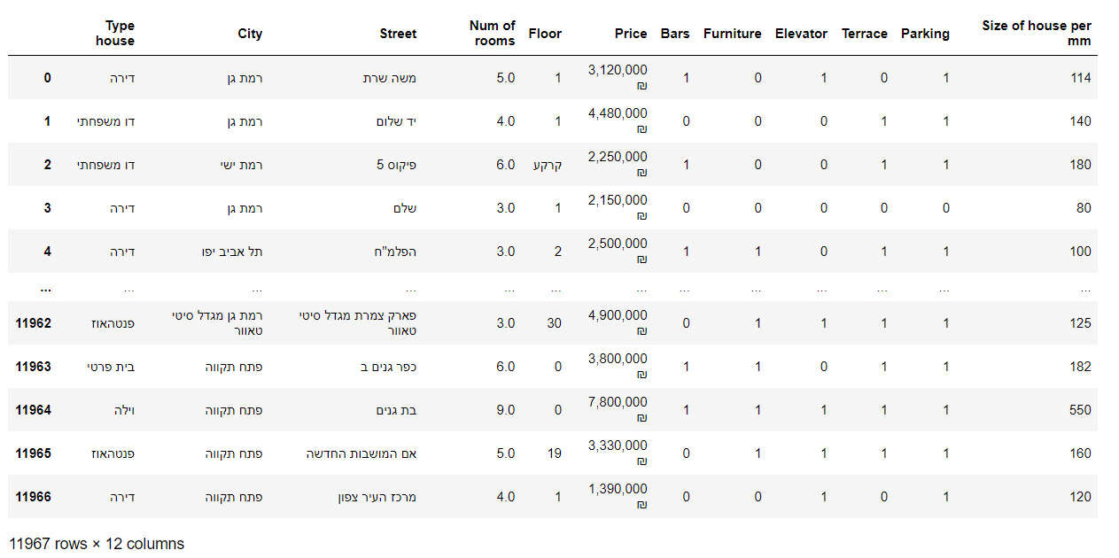
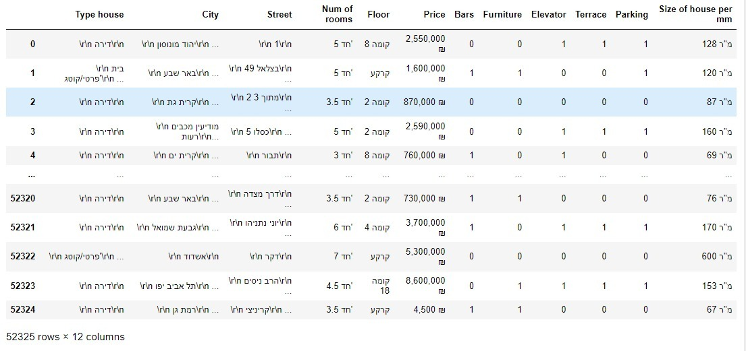
Web Crawling
From the first site, we were able to pull with the Beautifulsoup method about 144,000 data on different apartments in different locations in Israel. (Among the data: price of the apartment, city, street, floor, number of rooms and more …)
From the "AD" site using the same method, we were able to pull about 627,900 data

Slide 6
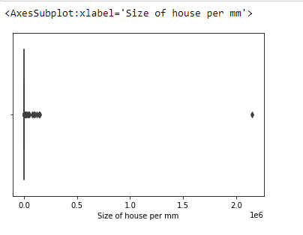
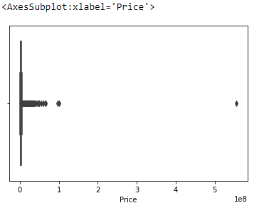
outliers
outliers
Scrubbing Data
Dealing with missing values:
Dropping rows and columns with too many missing values
Dealing with duplicates:
I have a tiny number of duplicates rows, which contained the exact same values, so I kept only the first ones
Cleaning the noise:
Many strings contained unnecessary signs, duplicated words and so on, so I built some “cleaning” methods
Also, We deleted outliers, but not all of them, only the most exceptional
Formatting:
Importing every non–numeric variable into a fitted categorical data

Slide 7
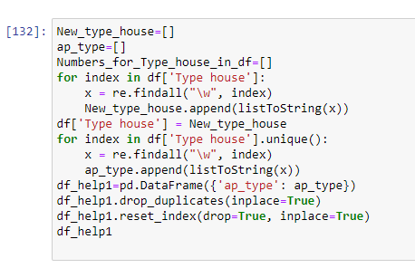
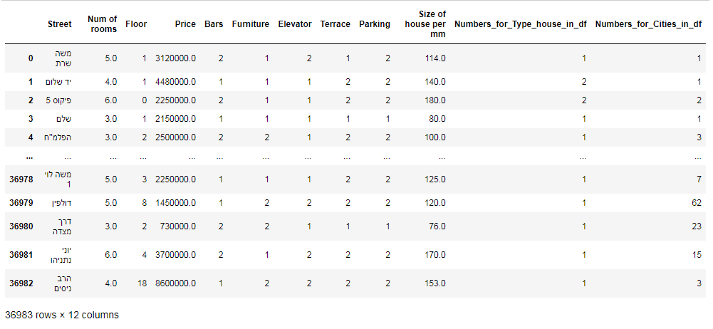
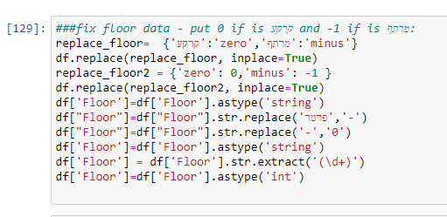
Scrubbing Data
We combined the information of the two sites, cleaned up the data and got the following table:

Slide 8
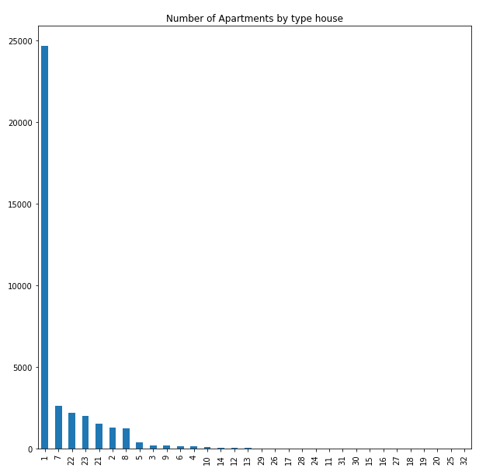
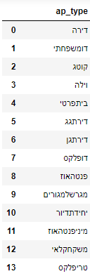
Exploring & Visualizing the Data
First, we created a dictionary that converts the type of apartment to a numeric number.
Then we used the dictionary on the house type column in df, and we got that an "apartment" type house is the most common for sale.

Slide 9
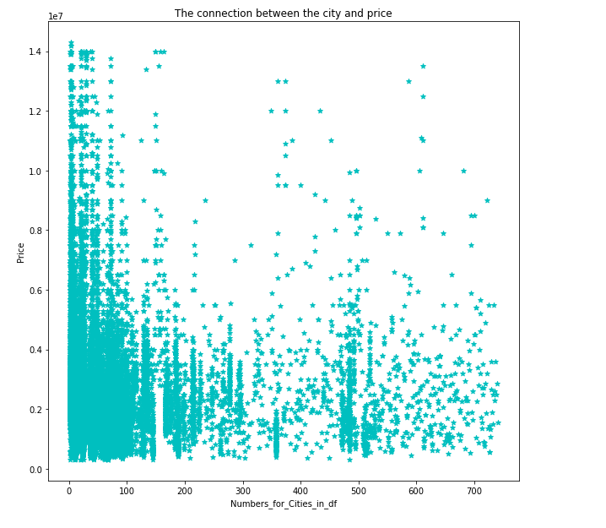
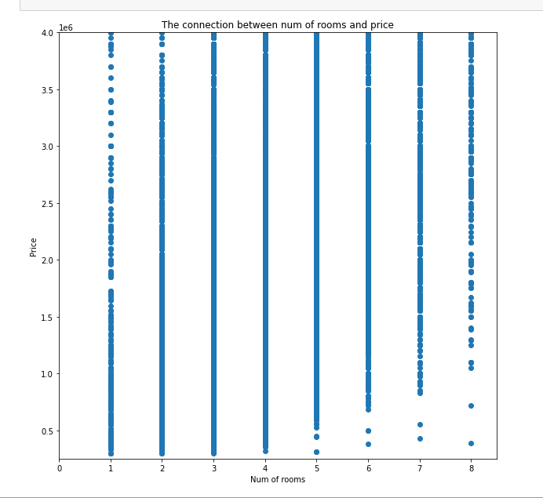
Exploring & Visualizing the Data
Then, using the scatter plot method, we examined the relationship between the price of an apartment with some parameters.

Slide 10
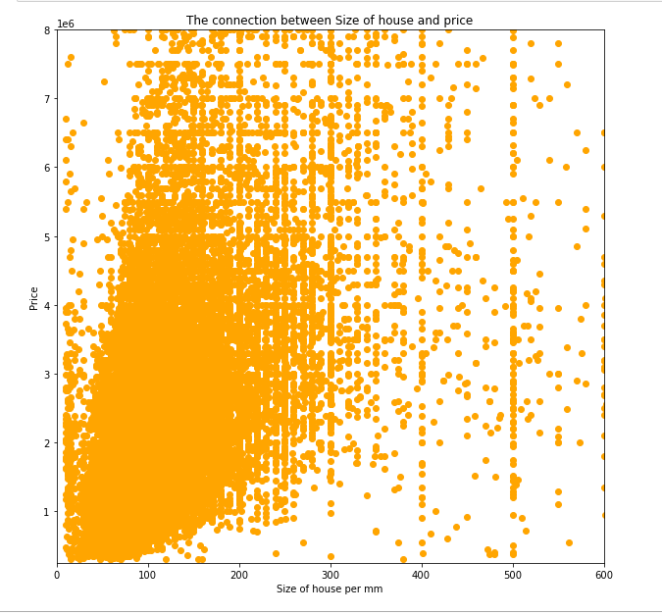
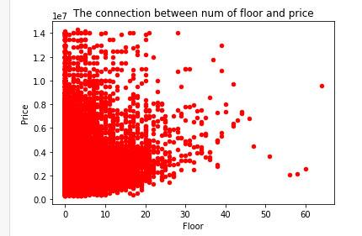
Exploring & Visualizing the Data
As we saw through the scatter plot, there is connection between the difference of parameters to the price of apartment

Slide 11


Machine Learning
linear regression
Using `sklearn` library and linear regression
we were able to train a model that predicts the price of apartment
we were able to train a model that predicts the price of apartment As a dependency on city

Slide 12
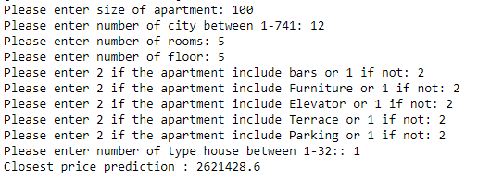
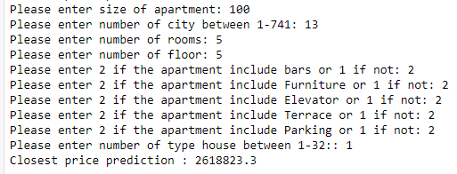
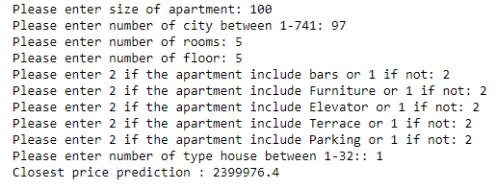
Machine Learning
Rehovot
Ashqelon
Using `sklearn` library and logistic regression, we were able to train a model that predicts the apartment price
Eilat
We see that the price changed in different areas of the country (north, south, center) in Tel Aviv - the price of a five-room apartment will be higher than in Eilat

Slide 13
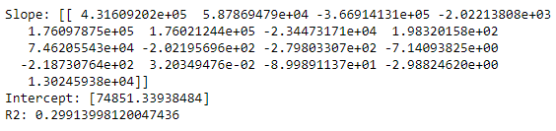
Machine Learning
After we done machine learning, we can say that it is difficult to predict the price of an apartment by its location in the country.
Our model can predict the price with an accuracy of 0.3
In our opinion - the reason is because there are many cities.
This makes it difficult for the model to be accurate.

Slide 14
How can the model be improved?
Divide the cities by regions in the country: north, south, center.
Collect more data so that the model can train himself with more information.
Searching for additional algorithms that we have not learned.

Slide 15

In Conclusion
The work process was very enjoyable, from mining the data to learning the machine.
During the project we got stuck in difficulties, in which we had to use thinking in order to overcome them.
Unfortunately, we have not reached an unequivocal answer regarding the question of our project.
If we had more time - we would try to achieve higher success rates in machine learning.

